Slide 1
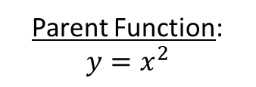
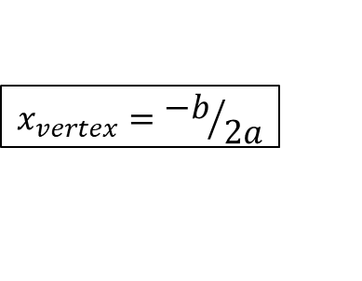
Forms of the Quadratic Equation
Zeroes: $x=\frac{−b}{2a}±\frac{\sqrt{b^{2}−4ac}}{2a}$
Zeroes: convert to intercept form
Standard form
Zeroes: convert to intercept form
$$x_{vertex}={−b}/{2a}$$
Factoring
Parent Function:
$$y=x^{2}$$
Vertex form
Intercept Form
$$y=a(x−p)(x−q)$$
Zeroes: “Isolate the square, undo the square”
$x_{vertex}=\frac{x_{1}+x_{2}}{2}$
(average of the x-intercepts)
Zeroes: use the zero product property
Zeroes: convert to vertex form

