Slide 1
Math-1050 Session #30 (12.3: Determinants
Understanding how to find the “determinant” of a matrix will help us to use Matrices to solve systems equations.

Slide 2
(1) Rewrite as a matrix equation
2x – 3y = 8
7x + 2y = 2
2 –3 8
7 2 2
x
y
=
We find determinants of square matrices.
2 -3
7 2
2 -3
7 2
det
=
A matrix has ‘curved’ brackets
The determinant of a matrix has ‘straight’ brackets

Slide 3
Determinant of a 2x2 Matrix
the product of the “main diagonal” subtract the product of the other diagonal.
2 -3
7 2
= (2)(2)
– (7)(-3)
= 4 + 21
= 25
ax – by = s
cx + dy = t

Slide 4
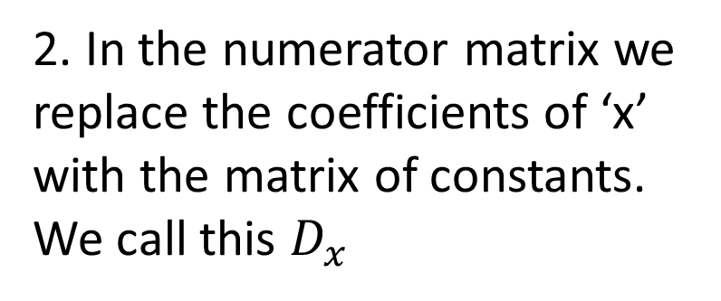
Matrix of Coefficients
3 -6
5 4
24
12
3x - 6y = 24
5x + 4y = 12
Matrix of Constants
1. To solve for ‘x’ we make a ratio of determinants of the matrix of coefficients.
2. In the numerator matrix we replace the coefficients of ‘x’ with the matrix of constants.
We call this $D_{x}$
3 -6
5 4
24 -6
12 4
det
det
x =
x =
3 -6
5 4
det
3 -6
5 4
det

Slide 5
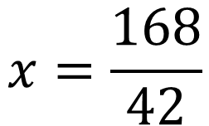
Matrix of Coefficients
3 -6
5 4
24
12
3x - 6y = 24
5x + 4y = 12
Matrix of Constants
3. Find the ratio of determinants.
24 -6
12 4
det
= (24)(4)
– (12)(-6)
= 168
x =
3 -6
5 4
det
= (3)(4)
– (5)(-6)
= 42
$$x=\frac{168}{42}$$
$$x=4$$

Slide 6
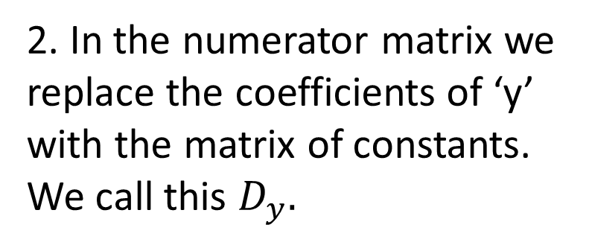
Matrix of Coefficients
3 -6
5 4
24
12
3x - 6y = 24
5x + 4y = 12
Matrix of Constants
1. To solve for ‘y’ we make a ratio of determinants of the matrix of coefficients.
2. In the numerator matrix we replace the coefficients of ‘y’ with the matrix of constants. We call this $D_{y}.$
3 -6
5 4
3 24
5 12
det
det
y =
y =
3 -6
5 4
det
3 -6
5 4
det

Slide 7
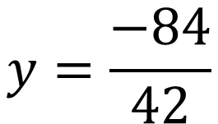
Matrix of Coefficients
3 -6
5 4
24
12
3x - 6y = 24
5x + 4y = 12
Matrix of Constants
3. Find the ratio of determinants.
3 24
5 12
det
= (3)(12)
– (5)(24)
= -84
y =
3 -6
5 4
det
= (3)(4)
– (5)(-6)
= 42
$$y=\frac{−84}{42}$$
$$x=−2$$

Slide 8
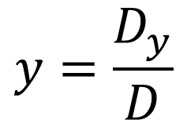
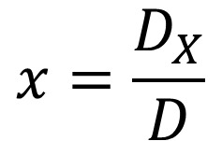
The ‘x-value’ of the solution is a ratio of determinants. The numerator matrix is the matrix of coefficients with the ‘x-term’ coefficients replace with the matrix of constants.
$$x=\frac{D_{X}}{D}$$
The ‘y-value’ of the solution is a ratio of determinants. The numerator matrix is the matrix of coefficients with the ‘y-term’ coefficients replace with the matrix of constants.
$$y=\frac{D_{y}}{D}$$

Slide 9
Solve the system using “Cramer’s Rule”
x + 3y = 5
2x - 3y = -8

Slide 10
What about 3x3 Matrices?
3 1 7
-3 5 6
2 -1 -3
3 1 7
-3 5 6
2 -1 -3
det
=

Slide 11
One method, not taught in the textbook.
1) Copy the first two columns and put them to the right side of the matrix.
2) Add the products of the main diagonals.
3 1 7
-3 5 6
2 -1 -3
3 1
-3 5
2 -1
Sum of main diagonal products
(-45
+ 12
+ 21)
= -12

Slide 12
3) Add the products of the opposite diagonals.
Sum of main diagonal products
3 1 7
-3 5 6
2 -1 -3
3 1
-3 5
2 -1
Det A = (-12) – (61)
+ (-18)
= 61
70
+ 9
Sum of opposite diagonal products

Slide 13
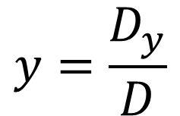
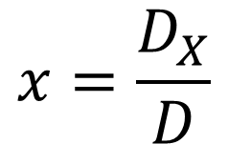
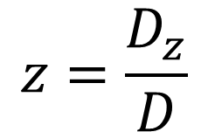
Cramer’s Rule For 3 Equations with 3 unknowns
det
The ‘x-value’ of the solution will be the ratio of 2 determinants.
x (or y or z) =
det
The numerator matrix is the matrix of coefficients with the ‘x-term’ coefficients replaced with the matrix of constants.
$$x=\frac{D_{X}}{D}$$
$$y=\frac{D_{y}}{D}$$
$$z=\frac{D_{z}}{D}$$
The same pattern is used to find the y-value of the solution and the z-value of the solution.

Slide 14
1. Copy the coefficient matrix into top and bottom.
a b c d e f g h i
det
2. Replace the “x”
coefficients in the
numerator with the
matrix of constants.
x =
a b c d e f g h i
det
3. “Do the math”.

Slide 15
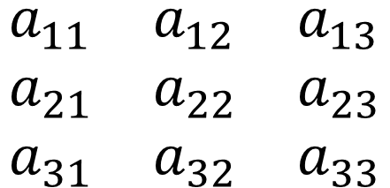
The textbook’s method of finding the determinant of a larger square matrix.
‘a’ is a coefficient of variables in the matrix of coefficients. The first column is the coefficients of the ‘x’ variable, the 2nd column is the coefficients of the ‘y variables, etc.
$$\begin{matrix}a_{11} & a_{12} & a_{13} \\ a_{21} & a_{22} & a_{23} \\ a_{31} & a_{32} & a_{33}\end{matrix}$$
The subscripts (11), (12), (13), etc., refer to the position of the number in the matrix. The 1st number is the row number. The second number is the column number.
$$a_{32}$$
refers to the number in the matrix that is in the 3rd row and 2nd column.

Slide 16
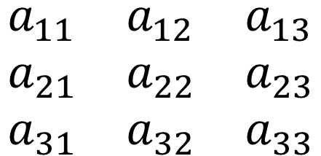
Notice that the side are straight → we are trying to find the determinant of this matrix.
$$\begin{matrix}a_{11} & a_{12} & a_{13} \\ a_{21} & a_{22} & a_{23} \\ a_{31} & a_{32} & a_{33}\end{matrix}$$
The 2x2 matrix remaining after the row and column containing is removed.
$$a_{11}$$
$${=a}_{11}\left|\begin{matrix}a_{22} & a_{23} \\ a_{32} & a_{33}\end{matrix}\right|$$
$${−a}_{12}\left|\begin{matrix}a_{21} & a_{23} \\ a_{31} & a_{33}\end{matrix}\right|$$
$${+a}_{13}\left|\begin{matrix}a_{21} & a_{22} \\ a_{31} & a_{32}\end{matrix}\right|$$
The determinant of this 2x2 matrix is called a “minor” of the 3x3 matrix.
$$M_{11}$$
The first “minor” above is called because it is the 2x2 matrix remaining after the 1st row and the 1st column have been removed.

Slide 17
$$m_{23}$$
Find for the matrix below.
1) Delete row 2
3 1 7
-3 5 6
2 -1 -3
2) Delete column 3
3) Find the determinant of the remaining 2x2 matrix.
3 1
2 -1
= (3)(-1)
– (2)(1)
$$M_{23}=−5$$

Slide 18
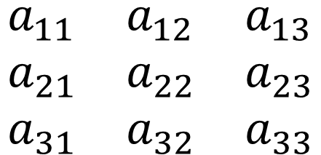
$$\begin{matrix}a_{11} & a_{12} & a_{13} \\ a_{21} & a_{22} & a_{23} \\ a_{31} & a_{32} & a_{33}\end{matrix}$$
The “minor” (with its correct sign) is called the “cofactor”.
“cofactor” $A_{ij}={\left(−1\right)}^{(i+j)}M_{ij}$
$$M_{11}$$
$$M_{12}$$
$$M_{13}$$
$${=a}_{11}\left|\begin{matrix}a_{22} & a_{23} \\ a_{32} & a_{33}\end{matrix}\right|$$
$${−a}_{12}\left|\begin{matrix}a_{21} & a_{23} \\ a_{31} & a_{33}\end{matrix}\right|$$
$${+a}_{13}\left|\begin{matrix}a_{21} & a_{22} \\ a_{31} & a_{32}\end{matrix}\right|$$
“cofactor”
“cofactor”
“cofactor”
$${=a}_{11}∗A_{11}+a_{12}∗A_{12}+a_{13}∗A_{13}$$
“factor”
“cofactor”

Slide 19
“cofactor” $A_{ij}={\left(−1\right)}^{(i+j)}M_{ij}$
$$A_{23}$$
Find cofactor for the matrix below.
3 1 7
-3 5 6
2 -1 -3
“cofactor” $A_{23}={\left(−1\right)}^{(2+3)}M_{23}$
1) Delete row 2
2) Delete column 3
3) Find the determinant of the remaining 2x2 matrix.
3 1
2 -1
= (3)(-1)
– (2)(1)
$$m_{23}=−5$$
“cofactor” $A_{23}={\left(−1\right)}^{\left(2+3\right)}(−5)$
“cofactor” $A_{23}=5$
$${a_{23}∗A}_{23}=5$$
$$6∗5=30$$

Slide 20
3 1 7
-3 5 6
2 -1 -3
3 1 7
-3 5 6
2 -1 -3
3 1 7
-3 5 6
2 -1 -3
$$\begin{matrix}a_{11} & a_{12} & a_{13} \\ a_{21} & a_{22} & a_{23} \\ a_{31} & a_{32} & a_{33}\end{matrix}$$
$${=a}_{11}∗A_{11}+a_{12}∗A_{12}+a_{13}∗A_{13}$$
$$A_{ij}={\left(−1\right)}^{(i+j)}M_{ij}$$
$${=a}_{11}\left|\begin{matrix}a_{22} & a_{23} \\ a_{32} & a_{33}\end{matrix}\right|$$
$${−a}_{12}\left|\begin{matrix}a_{21} & a_{23} \\ a_{31} & a_{33}\end{matrix}\right|$$
$${+a}_{13}\left|\begin{matrix}a_{21} & a_{22} \\ a_{31} & a_{32}\end{matrix}\right|$$
$$M_{11}=\left(5\right)\left(−3\right)−\left(−1\right)\left(6\right)=−9$$
$$A_{11}={\left(−1\right)}^{\left(1+1\right)}(−9)$$
$$A_{11}=−9$$
$$M_{12}=\left(−3\right)\left(−3\right)−\left(2\right)\left(6\right)=−3$$
$$A_{12}={\left(−1\right)}^{\left(1+2\right)}(−3)$$
$$A_{12}=3$$
$$M_{13}=\left(−3\right)\left(−1\right)−\left(2\right)\left(5\right)=−7$$
$$A_{13}={\left(−1\right)}^{\left(1+3\right)}(−7)$$
$$A_{12}=−7$$

Slide 21
3 1 7
-3 5 6
2 -1 -3
3 1 7
-3 5 6
2 -1 -3
3 1 7
-3 5 6
2 -1 -3
$$\begin{matrix}a_{11} & a_{12} & a_{13} \\ a_{21} & a_{22} & a_{23} \\ a_{31} & a_{32} & a_{33}\end{matrix}$$
$${=a}_{11}∗A_{11}+a_{12}∗A_{12}+a_{13}∗A_{13}$$
$$A_{ij}={\left(−1\right)}^{(i+j)}M_{ij}$$
$${=a}_{11}\left|\begin{matrix}a_{22} & a_{23} \\ a_{32} & a_{33}\end{matrix}\right|$$
$${−a}_{12}\left|\begin{matrix}a_{21} & a_{23} \\ a_{31} & a_{33}\end{matrix}\right|$$
$${+a}_{13}\left|\begin{matrix}a_{21} & a_{22} \\ a_{31} & a_{32}\end{matrix}\right|$$
$$A_{11}=−9$$
$$A_{12}=3$$
$$A_{12}=−7$$
$$a_{11}=3$$
$$a_{12}=1$$
$$a_{17}=7$$
$${D=a}_{11}∗A_{11}+a_{12}∗A_{12}+a_{13}∗A_{13}$$
$$D=\left(3\right)\left(−9\right)+\left(1\right)\left(3\right)+(7)(−7)$$
$$D=−73$$
$$D=−27+\left(3\right)−49$$

